Slide 1


KARNAVATI UNIVERSITY
Unitedworld Institute of Technology
Website Redirection System
Professional Training
Semester: 4th
Programme: B. Sc. (Hon’s)
Guided by:
Ms. Rama M. Maliya and Mr. Sanjay Ajani
Assistant Professor
UIT, KU
Prepared by:
Harsh Shroff (20220701057)

Slide 2




FRONT END
TECHNOLOGY
HTML
Java Script
BACKEND
TECHNOLOGY

Slide 3

PROJECT
Functionalities
IT guides you to the website of your desired car company
. When it comes to designing a website login functionality, simplicity is key. The login page should be straightforward and easy to navigate, allowing users to quickly log in to their accounts. It's important to only ask for essential information, such as an email address and password, and to make it clear where users should enter this information.

Slide 4
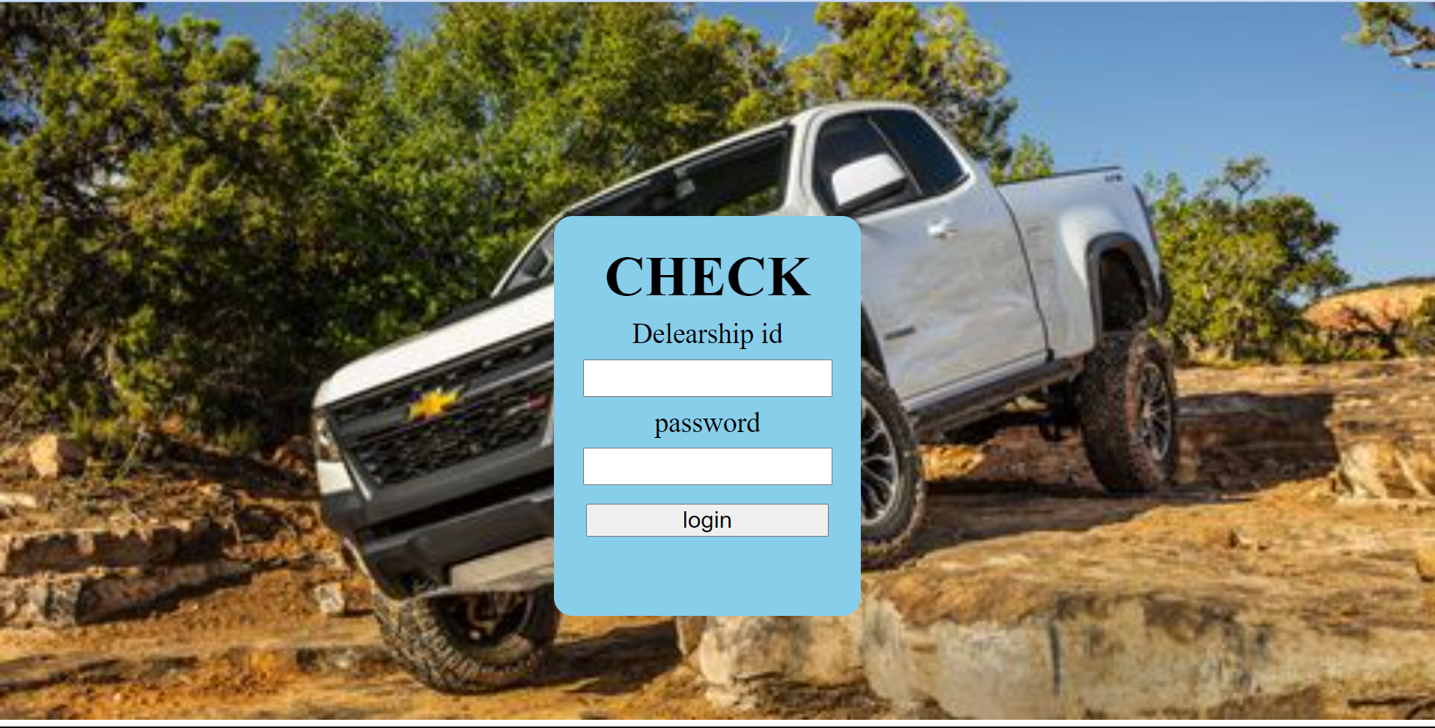
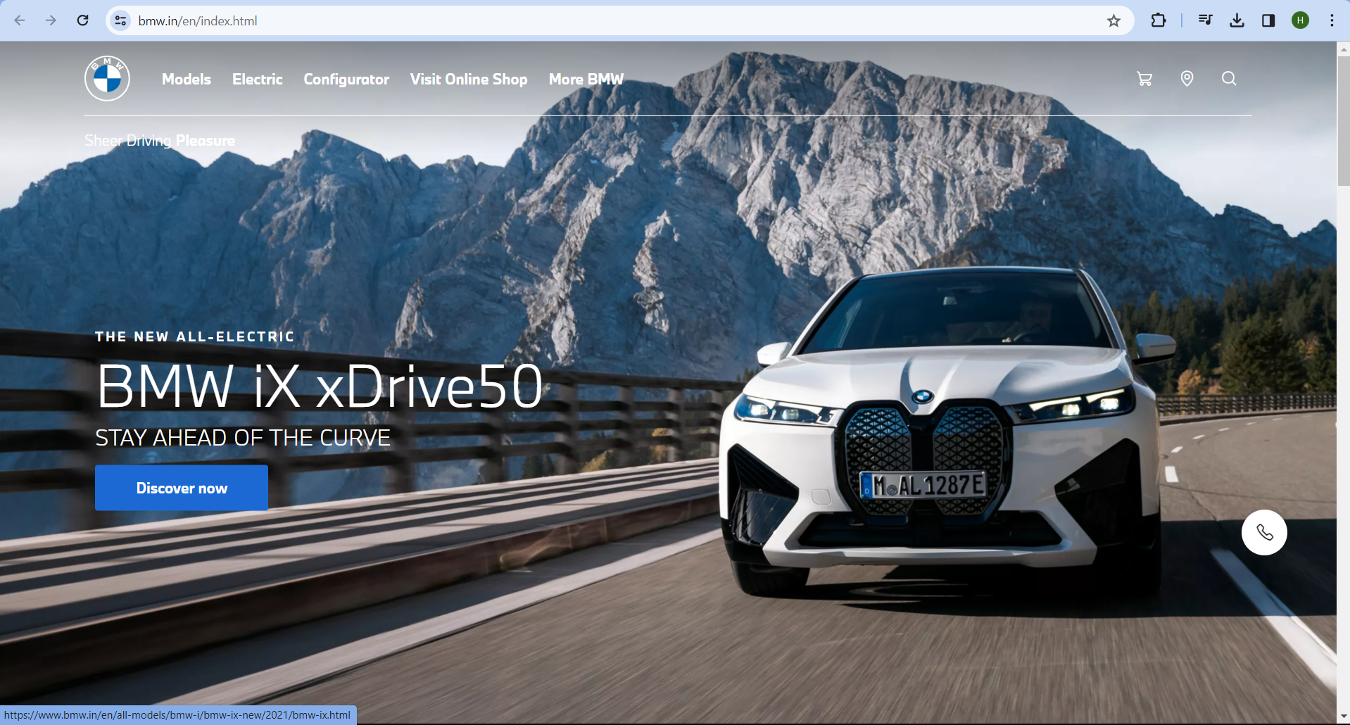
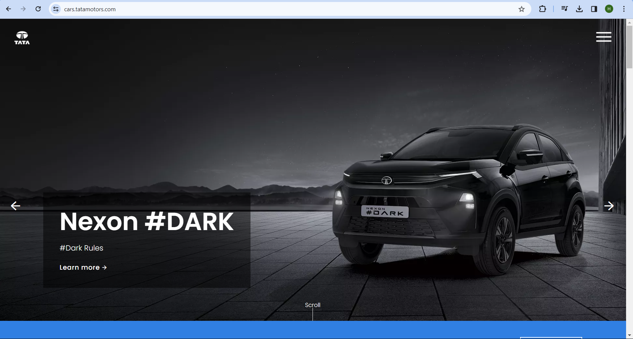
PROJECT
Screenshots

Slide 5
PROJECT LINK
GitHub Link:
OR
Drive Link:

Slide 6
THANK YOU

